Slide 1
BANK CUSTOMER CHURN
Sheetal Murali, Yenifer Aristizabal

Slide 2
TABLE OF CONTENTS
01
04
02
05
03
06
Business Understanding
Results and Evaluation
Data Understanding and Preparation
Recommendations
Faith and Ethics Implications
Modeling

Slide 3
Businness Understanding
Business Problem
Business Goal
Data Mining Goal
Retaining a new customer is anywhere from 5 to 25 times more expensive.
The banking sector, particularly in North America, experiences an annual churn rate of around 11%.
This will be to reduce Customer Churn by lowering the rate at which clients leave the bank. .
Use predictive analytics to find trends and factors contributing to client churn.

Slide 4
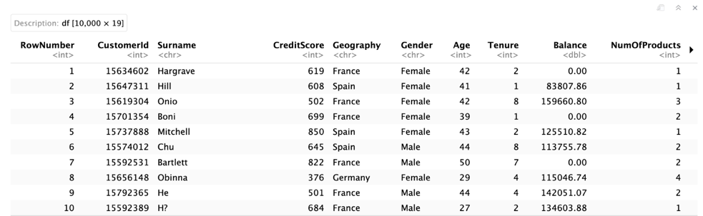
Data Understanding and Preparation
Data description

Slide 5
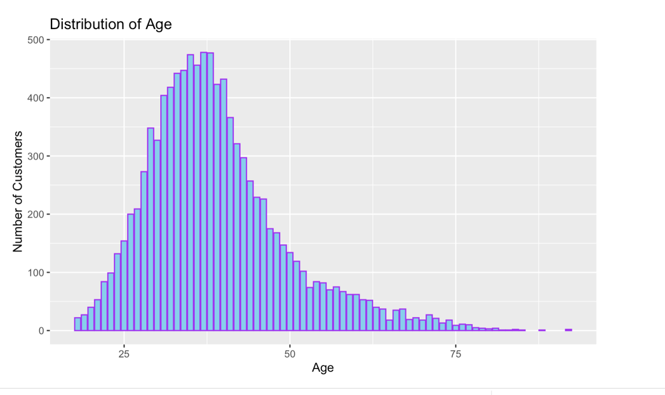
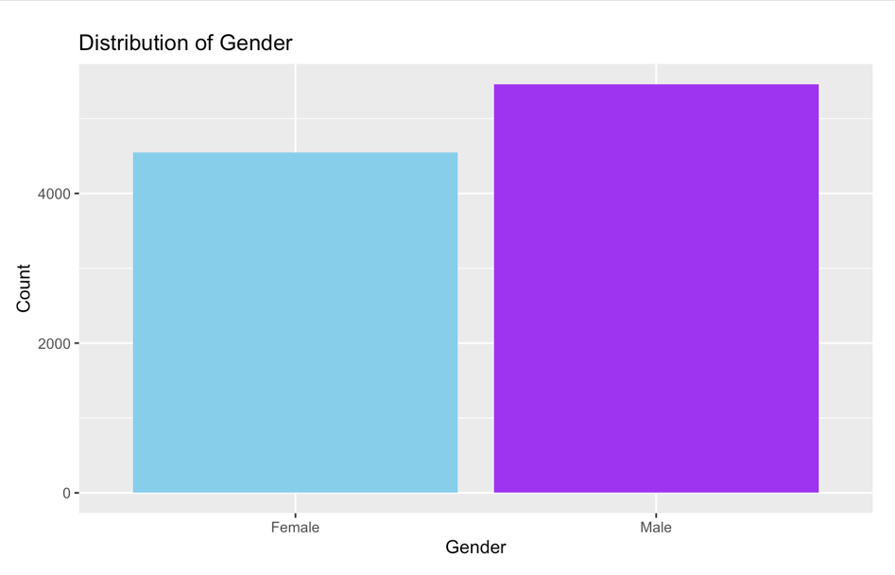
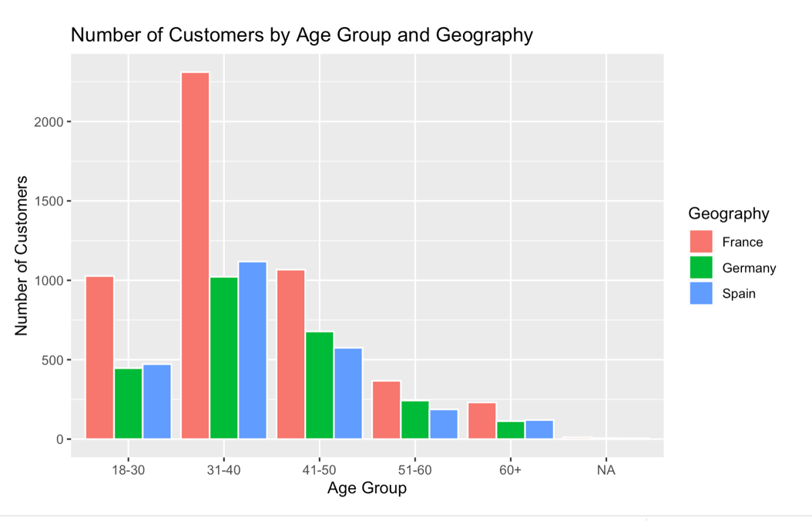
Exploratory Data Analysis (EDA)
Distribution of Customer’s age
Distribution of Customer’s Gender
Number of Customers by Group Age and Geography

Slide 6
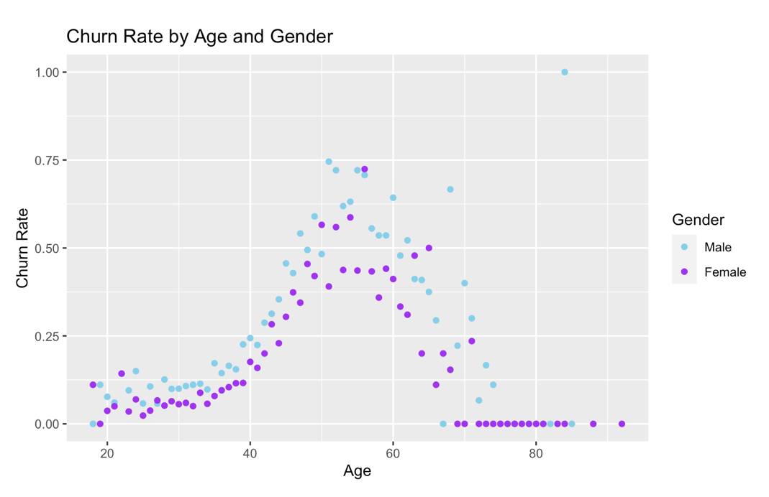
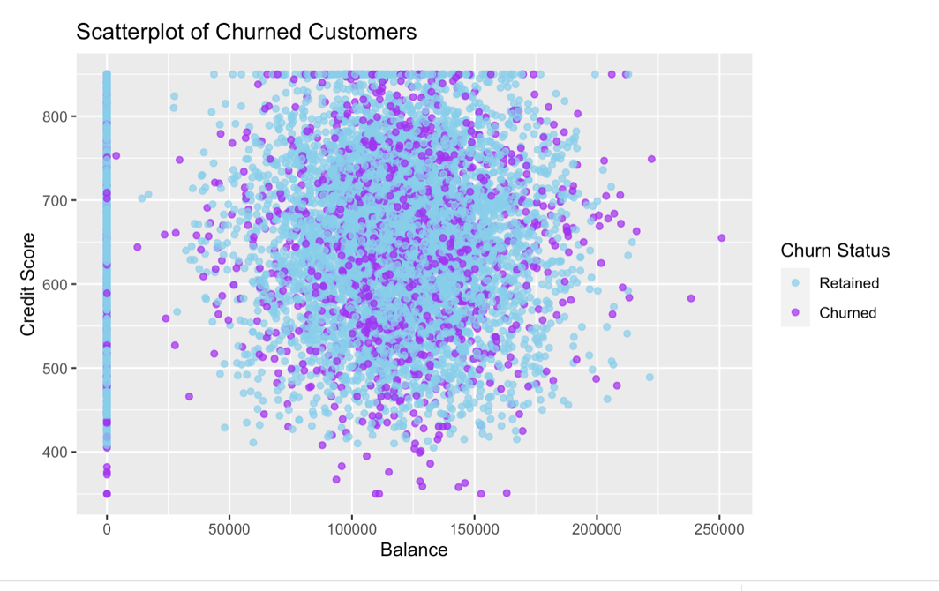
Customer’s Churned Based on Credit Score and Balance
Customer’s Churn Rate by Age and Gender.

Slide 7
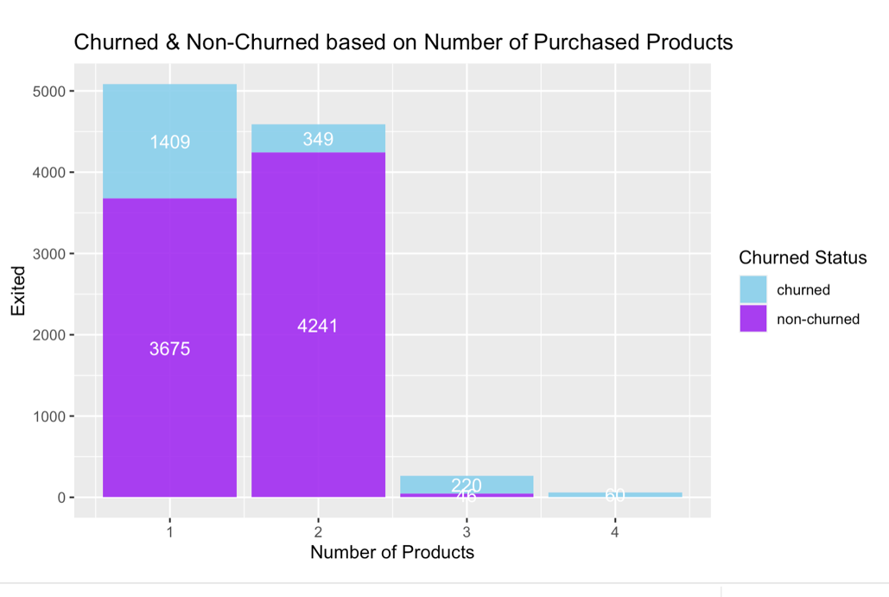
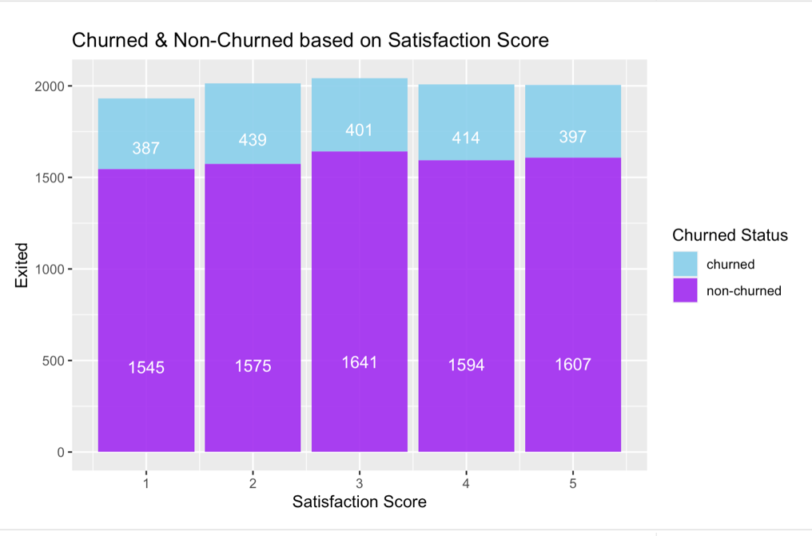
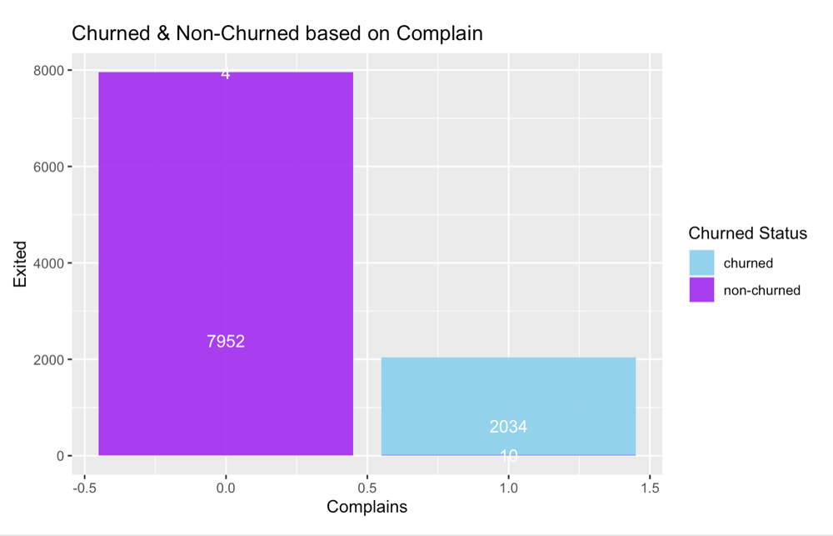
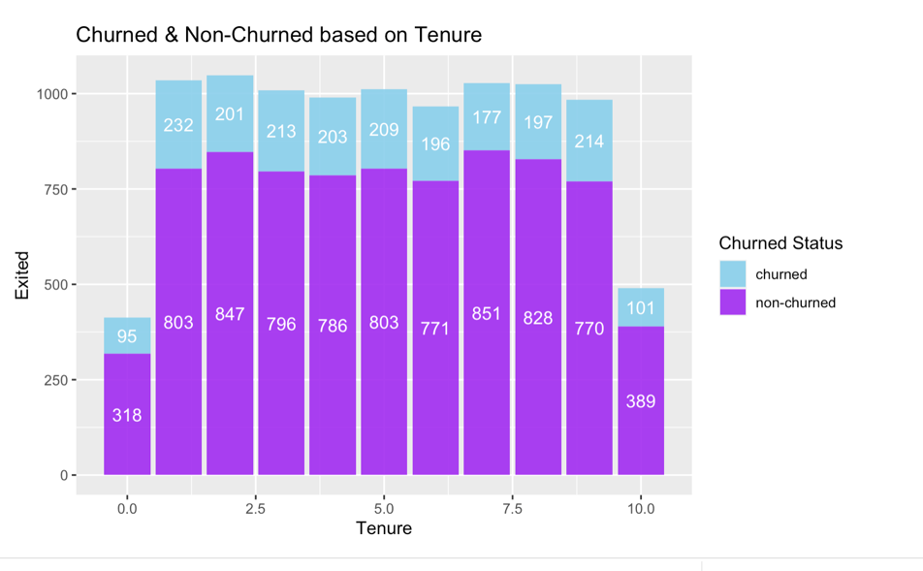
Customer’s Churn Based on Number of Purchased Products.
Customer’s Churn Based on Satisfaction Score.
Customer’s Churn Based on Complains
Customer’s Churn Based on Tenure

Slide 8
MODELS
Logistic Regression | To predict whether a customer is likely to exit the bank
Logistic Regression | To predict whether a customer is likely to file a complaint
Chi-Square test | To find the association between Geographical Location and Customer Churn
Two Sampled t-test | To compare the Mean customer churn of Males and Females
ANOVA | Test whether age, tenure, credit score, balance, products purchased have an effect on Exited Customers

Slide 9
Results and Evaluation
Variable "Complain" is highly significant with a p-value (< 2e-16) close to zero and Age (0.000118).
For the second Logistic regression, The variable "Exited" is highly significant with a very low p-value.
We can see the importance of a robust customer service strategy and effective complaint resolution processes to retain customers.
Logistic Regression

Slide 10
Two Sampled T-test
(H0): Mean Customer Churn for males is equal to Mean Customer Churn for females
(Ha): Mean Customer Churn for males is not equal to Mean Customer Churn for females
t-value is 10.536, Confidence Level 0.95
The null hypothesis (H0) is rejected, indicating that the mean customer churn for males is not equal to the mean customer churn for females.
reflect varying preferences, satisfaction levels, or experiences with the product or service offered

Slide 11
Chi-Square Test
The null hypothesis (H0) is rejected, indicating that there is an association between geographical location and customer churn.
Difference in expected and observed frequency. Ex. "France" category, the expected frequency of customers who churned is 1021.8532, but the observed frequency is 811.
H0): There is no association between Geographical Location and Customer Churn.
(H1): There is an association between Geographical Location and Customer Churn.

Slide 12
ANOVA
reject H0 because age, credit score, and balance have significant impacts on customer churn, while tenure and the number of products purchased do not have a significant impact.
"Age" has the highest F-value (898.271)
"Balance" has the highest Mean Square value (19.85)
customers with higher balances or older customers might exhibit different behaviors such as higher spending or lower churn rates.
(H0): There is no significant difference in the means of exited customers across different levels of age, tenure, credit score, balance, and products purchased.
(Ha): There is a significant difference in the means of exited customers across different levels of age, tenure, credit score, balance, and products purchased.

Slide 13

Recommendations
Handling Customer Complaints (Hult,2023)
Appreciating complaints
Allocate resources
Establish channels for complaints
Encourage customer Activity
Age-specific Marketing
Customer segmentation by Gender
Designing targeted interventions to reduce Churn rates.
Region – Specific goals

Slide 14
Faith and Ethics Implications
We must ensure that customers are informed about the data collection and analysis processes.
We must consider the broader societal implications of predicting and acting on customer churn
We must understand the customer's needs, values, and beliefs and regularly treat them with respect and dignity
Philippians 2:4 ‘‘Everyone should look out not only for his own interests but also for the interests of others’’,
We must regularly validate and update the models to ensure they remain accurate and relevant.
1 Corinthians 4:2 "Now it is required that those who have been given a trust must prove faithful."

Slide 15

Thank you

